Slide 1

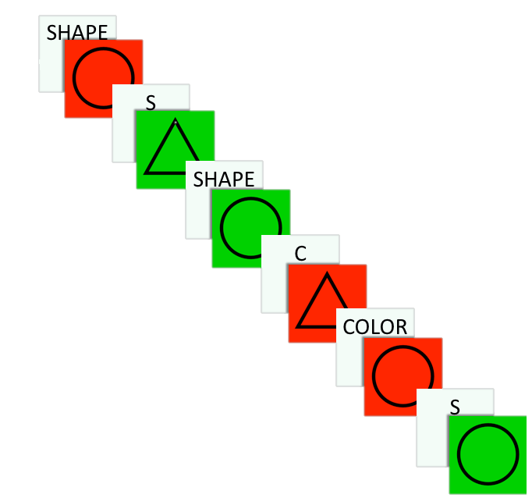
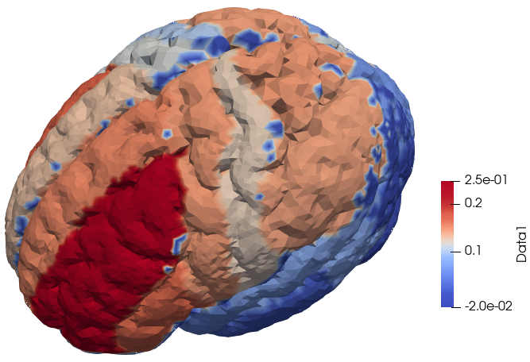
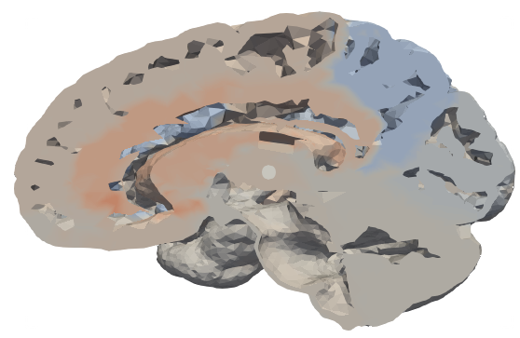
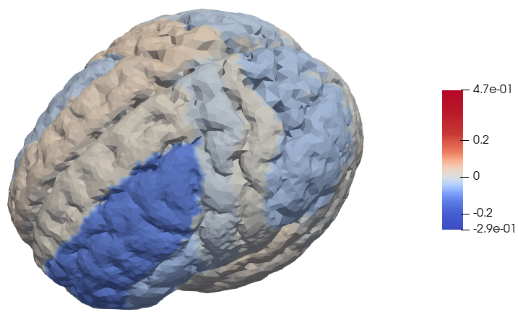
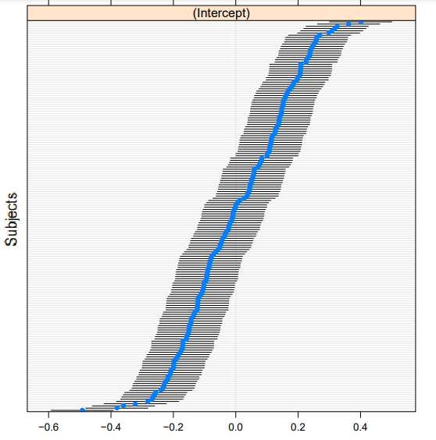
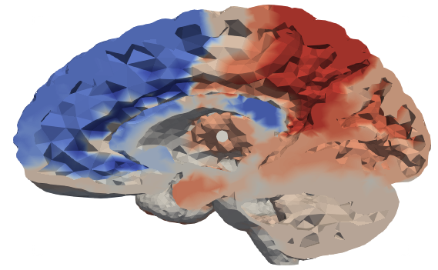
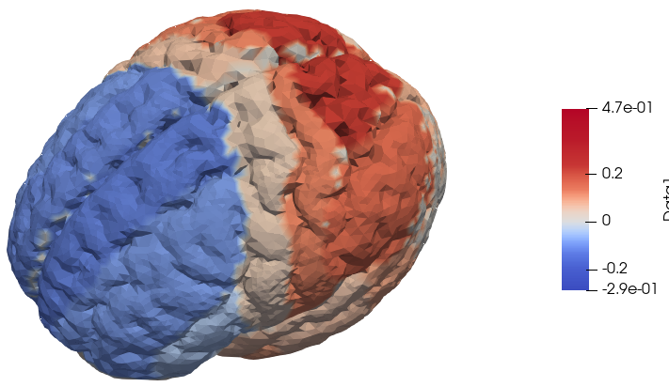
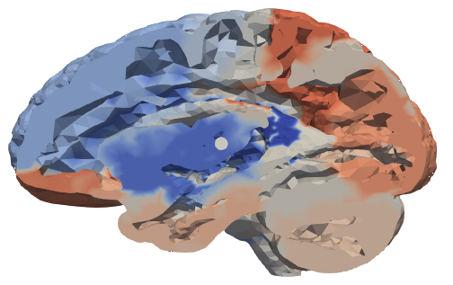
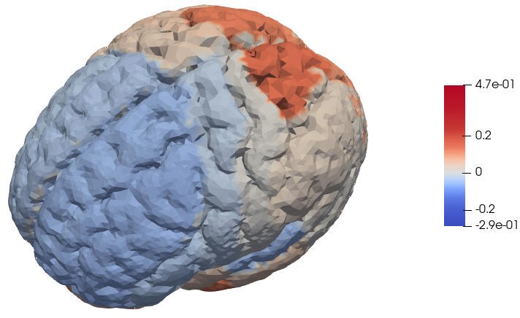

Case study on Human Brain Connectivity: Task-Switching in Schizophrenia Costanza Cantalini, Erica Bistacchia, Lorenzo Ferrara and Scott Pesenti
PRESENTATION OF THE CASE STUDY
OBJECTIVES
According to literature:
SCHZ are slower than CTRL but have comparable performance in the task switching test;
brain activity between SCHZ and CTRL differ in specific region activity.
Our objective was to verify or disprove these hypothesis.
INTRODUCTION
One of the regions hindered by schizophrenia is the dorsolateral prefrontal cortex (DLPFC) which has been associated to the ability of task switching (TS). Nevertheless, literature suggests that people affected by schizophrenia (SCHZ) do not perform worse than a neuro-typical control population (CTRL). Apparently SCHZ are simply slower in TS but reach the same tasks’ performances of CTRL. The literature assumes that this latter fact is possibly due to some unknown compensation mechanism in the SCHZ’s brain.
DESCRIPTION OF THE DATASET
175 participants (125 CTRL and 50 SCHZ).
For each participant:
Health-related data age and BMI
Functional connectivity map, a table of >36000 values, each corresponding to a node of the brain mesh on which the fMRI data was projected
Event recordings, a time step dataset composed of all the readings from the test, such as: reaction time, cue, answer.
CSI
TASK SWITCHING
While under fMRI, each participant was presented with a series of geometric shapes and asked to identify either the color or the shape of the image, based on the task cue presented prior to the image.
On 25% of trials the instructions switched, i.e., participants were instructed to switch from identifying shape to identifying color, or vice versa.
Sometimes there was congruency, that is when the wrong rule incidentally produces the same target answer.
We also have information about the correctness of their responses.
Incongruent
Task switch
Incongruent &
switching
DOSOLATERAL PREFONTAL CORTEX
Instructions
Red or Circle = Right button
Green or Triangle = Left button
REACTION TIMES
Normality: Shapiro test
➔ p-value = 0.016 (CTRL), p-value = 0.09 (SCHZ)
T-test on the means of the Reaction Times: CTRL vs SCHZ
p-value ≈ 0
Confidence interval for the difference of the means:
[ 0.173, 0.232, 0.292]
FRASETTA CONCLUSIVA
EXPLORATORY ANALYSIS
PSYCHOLOGICAL TRAITS: BARRATT IMPULSIVENESS SCORES
Impulsivity is the predisposition toward rapid unplanned
reactions.
T-test on the Scores of the Barratt Impulsivity Test (BIS) :
SCHZ scores vs CTRL scores.
p-value ≈ 1.
Reaction Time ~ BIS
But BIS did not turn out a
statistically significant regressor.
CONFOUNDING FACTORS
Reaction Time ~ Age + BMI + Diagnosis + Age : Diagnosis + BMI : Diagnosis +
Age : BMI + Age : BMI : Diagnosis
Only age and Diagnosis resulted as the only statistically significant regressors (see Fig 5) and no interaction seems to be important.
RESULTS
PERFORMANCE ANALYSIS
Performance is measured through:
Switch cost: $μ$_{Switch} – $μ$ _{noSwitch} = mean time during switch trials - mean time during nonswitch trials
Correct cost: $μ$_{Correct} - $μ$_{nonCorrect} = mean time during correct trials - mean time during noncorrect trials
General accuracy rate: #correct / #total
Switch accuracy rates:
#errors_on_Switch / #total_Switch
#errors_on_Switch / #total
Analysis:
Switch Costs and Correct Costs;
ANOVA;
analysis of error/accuracy rates.
ANOVA
Reaction Time ~ diagnosis + congruent + switch + diagnosis *congruent + diagnosis *switch +
+ congruent*switch
PRINCIPAL COMPONENT ANALYSIS
First, since the number of features was greater than the number of samples (p>n), we aggregated the >36000 nodes of our brain mesh into the 83 canonical regions.
Then we performed a PCA on the functional connectivity maps of the participants to extract the principal features which might let us discriminate between the two groups.
It showed:
high significance of diagnosis and switch;
no interaction was statistically significant.
Stepwise reduction:
Reaction Time ~ diagnosis + switch
1ST PC
The first PC highlights an antagonism between optimization and attention redirection. Whenever a participant must switch, they will have to redirect their attention on the new task, while during non-switch trials the subject’s brain will optimize to the task at hand.
We can state that the difference between Switch Costs for SCHZ and CTRL are not statistically significant, switching seems not to hinder SCHZ’s reaction time more than CTRL.
Lateral ventricle, temporal horn (48) aids in the interaction between regions of the brain, sending cerebral fluid into regions where needed. Middle frontal gyrus (29) regulates the attention redirection mechanisms. Subcallosal area and frontal cortex (78-81) are responsible for regulating the reward and cognitive stress).
LINEAR MIXED MODEL
The previous ANOVA does not consider that times are not independent.
➔ Subjects' grouping as a Random Effect in a LMM
Reaction Time ~ diagnosis + switch + (1|Subject)
➔ PVRE = 0.8483049
The corresponding PVRE resulted extremely high, suggesting that most of the real variability must be assigned to the intrinsic differences between participants rather than the difference between two groups (see Fig. 45672).
2ND PC
The second PC highlights the brain’s prediction mechanism. Showing how the brain initially makes a prediction about external reality from biological signals (sensorial and emotional), rewarding itself if the prediction is accurate, also highlighting the delay between hand-eye coordination and the prediction.
Fig 3746: a)Box Plot of Reaction Time in Switch and Non-Switch events.
b) Box Plot of Switch Cost.
T-test on the mean of the Switch Cost (p=0.4643)
Superior parietal gyrus (62-63), manage hand-eye coordination. Cingulate gyrus (24-25) reconstruct reality from biological inputs. Nucleus accumbens (37) regulates emotional response. Subgenual frontal cortex and Subcallosal area (77-78) are responsible for regulating the reward mechanism).
CONSIDERATIONS ABOUT ACCURACY
➔ CTRL have higher accuracy
➔ SCHZ accuracy rate is lower than the CTRL one
➔ SCHZ accuracy on switch is higher than the CTRL one
The previous results falsifies what has been proposed in literature.
It appears that no compensating mechanism is necessary as the accuracy rate of SCHZ is lower than CTRL but seems independent of task switching.
3RD PC
The third PC highlights the regulation of dopamine release. It is the first PC where we can observe a visible difference in the scores between neurotypical and neurodivergent participants. Lower scores in the schizophrenic population show an unbalanced or ineffective production of dopamine (this is coherent with literature).
Fig. 384729: a) Box Plot of Reaction Times when participants answered correctly and not. b) Box Plot of Correct Cost. T-test on the mean of the Correct cost (p-value = 0.5299)
CONCLUSIONS
REFERENCES
The analyses of task performances falsify the hypothesis under concern as it appears SCHZ do not employ a compensatory mechanism in task-switching, rather displaying an insensitivity to task switching and overall worst results, modulated by a comparable speed-accuracy tradeoff with respect to CTRL. Indeed, our results indicate that SCHZ exhibit a higher reaction time and a lower accuracy rate than CTRL, but both results seem to be independent of task switching. This may occur because of the general difficulty of SCHZ to maintain and implement a task-set (configuration of perceptual, cognitive and response biases that serve to optimize task performance). According to this view, schizophrenic participants would retain less information and cognitive configuration across tasks, substantially making each trial independent of the previous one.
Our PCA fails to identify any significant difference in brain activation between SCHZ and CTRL. This suggests that the differing cognitive functioning between the two groups (in our case mostly evident as a general slowing) is to be seeked in the complex interaction between brain networks, rather than in the anomalous activation of just one or few selected regions. This is indeed the current line of research conducted by researchers of the MOX Department, where this intuition is put to the test through advanced non-parametric and functional statistical analysis techniques.
Finally, our LMM analysis sheds light on the non-negligible impact of variability across individuals. Specifically, the noticeable estimate we have obtained for PVRE advises caution over the possibility of attributing experimental variability to diagnosis alone.
[1] Susan M. Ravizza, Cameron S. Carter, Shifting set about task switching: Behavioral and neural evidence for distinct forms of cognitive flexibility, Neuropsychologia 46 (2008) 2924–2935
[2] Susan M. Ravizza, K.C. Keur Moua, Debra Long, Cameron S. Carter, The impact of context processing deficits on task-switching performance in schizophrenia, Schizophrenia Research 116 (2010) 274–279
[3] Alina Gomide Vasconcelos, Leandro Malloy-Diniz, Humberto Correa, SYSTEMATIC REVIEW OF PSYCHOMETRIC PROPRIETIES OF BARRATT IMPULSIVENESS SCALE VERSION 11 (BIS-11), Clinical Neuropsychiatry (2012) 9, 2, 61-74
[4] Nachshon Meiran, Joseph Levine, Naama Meiran and Avishai Henik, Task Set Switching in Schizophrenia, Neuropsychology 2000, Vol. 14, No. 3, 471-482
[5] Rotem Leshem, Relationships between trait impulsivity and cognitive control: the effect of attention switching on response inhibition and conflict resolution, Cogn Process (2016) 17:89–103
[6] Glenn R. Wylie, E. A. Clark, P. D. Butler and D. C. Javitt, Schizophrenia Patients Show Task Switching Deficits Consistent With N-Methyl-DAspartate System Dysfunction But Not Global Executive Deficits: Implications for Pathophysiology of Executive Dysfunction in Schizophrenia, Schizophrenia Bulletin vol. 36 no. 3 pp. 585–594, 2010
[7] Fred W. Sabb, Gerhard Hellemann, Nicholas B. Allen, Carrie E. Bearden, Enhanced switching and familial susceptibility for psychosis, Brain and Behavior. 2018;8:e00988
[8] S. Jamadar, P. Michie, F. Karayanidis, Compensatory mechanisms underlie intact task-switching performance in schizophrenia, Neuropsychologia 48 (2010) 1305–1323
[9] Dara S. Manoach, Kristen A. Lindgren, Mariya V. Cherkasova, Donald C. Goff, Elkan F. Halpern, James Intriligator, and Jason J.S. Barton, Schizophrenic Subjects Show Deficient Inhibition but Intact Task Switching on Saccadic Tasks, BIOL PSYCHIATRY 2002;51:816–826
[10] Paul D. Kieffaber, Emily S. Kappenman, Misty Bodkins, Anantha Shekhar, Brian F. O’Donnell, William P. Hetrick, Switch and maintenance of task set in schizophrenia, Schizophrenia Research 84 (2006) 345–358

